Slide 1
Welcome to Software Development Project-1

Slide 2

Mawlana Bhashani Science and Technology University
Course Title: Software Development Project-1
Course Code: ICT-1210
Presentation By:
Mst. Mostary Khatun
ID:IT-20036
Ashik Ahmed Sajib
ID:IT-20037
Tanvir Hasan
ID:IT-20038
Dept. of ICT, MBSTU
Supervised By:
Dr. Md. Abir Hossain
Associate Professor
Dept. of ICT, MBSTU
Date 8/6/2022

Slide 3
Project Name : snake and ladder

Slide 4
Objectives
1.To make entertainment.
2. Passing free time with enjoy.

Slide 5
Contents
Introduction
Short video
Flow chart
SYSTEM DESIGN
advantages
Limitation
Conclusion

Slide 6
introduction
Snake and ladder is well known game among children even among matured people.
The game is in two modes-two player and one player mode.
The number and position of the ladder and snake are generated fixed.

Slide 7
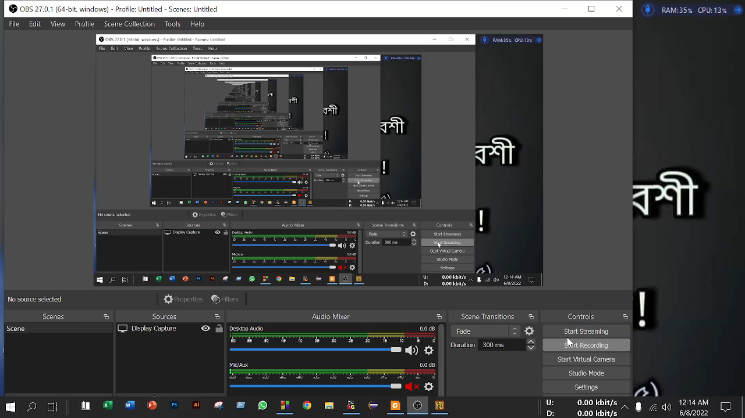
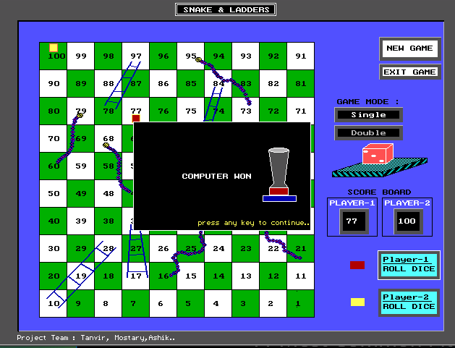
Short video output

Slide 8
Flow chart

Slide 9
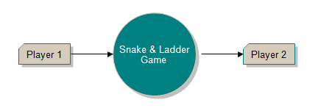
Level-1

Slide 10
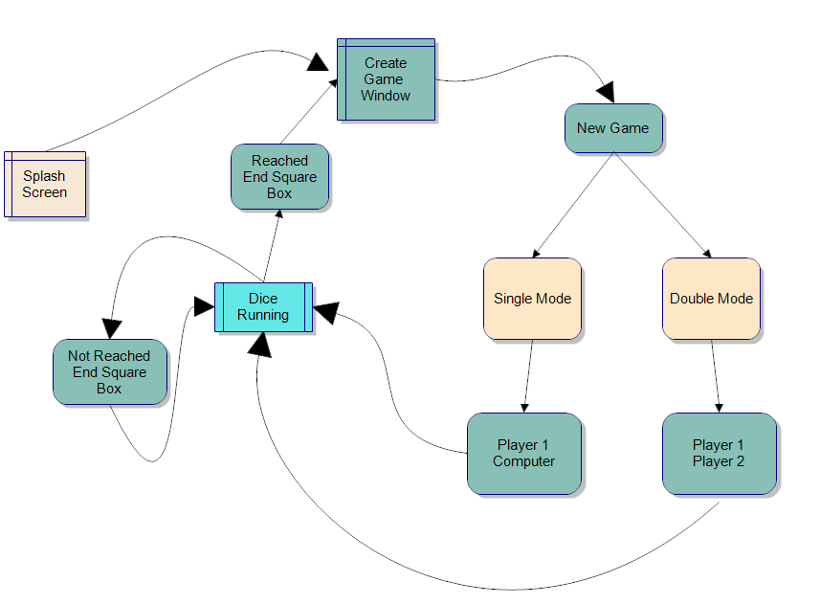
Level-2

Slide 11
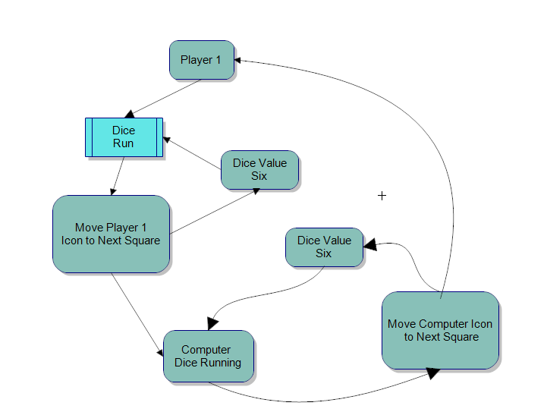
Level-3

Slide 12
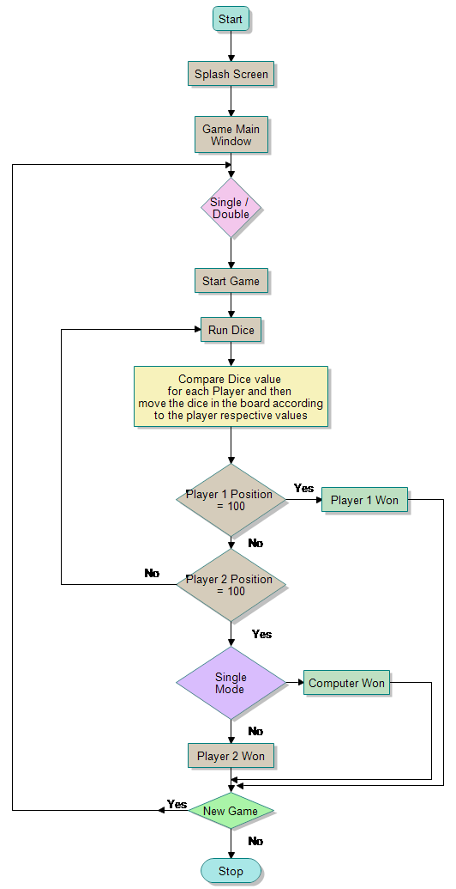
Main Flow Chart

Slide 13
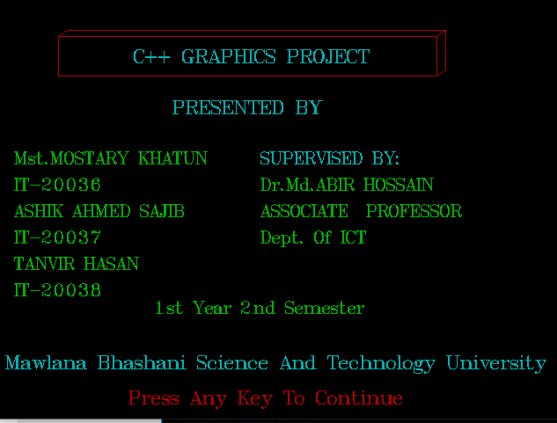
System Design

Slide 14
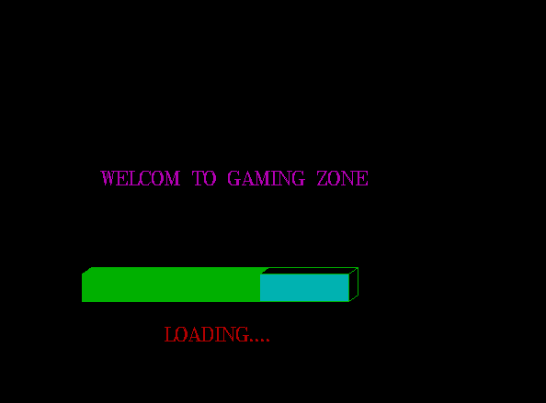
System Design

Slide 15

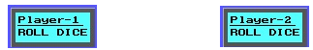

System Design

Slide 16
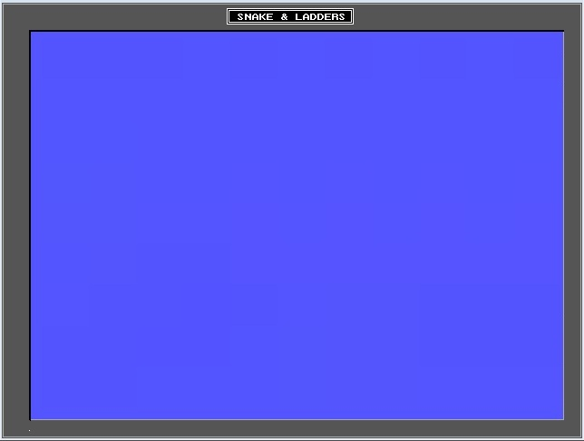
System Design

Slide 17
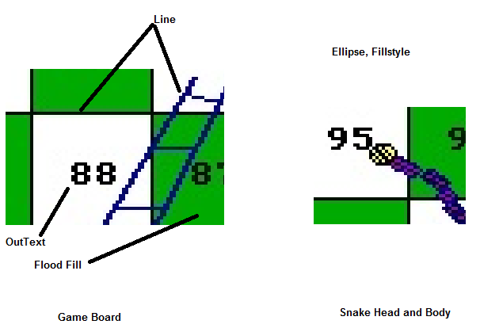
System Design

Slide 18
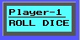
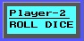
System Design

Slide 19

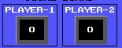
System Design

Slide 20
Advantage
Playing Snake helps to build the habit.
Brain funcationality is increased.
It helps relieve stress .
Players learn to manage anxiety.
It teaches us the importance of having a goal.

Slide 21
Limitation
We can’t save on the winner information.
We can’t input any player name.
Our project use more memory to execute.

Slide 22
Conclusion
Specially thanks to our honorable sir Associate Professor Dr. Md. Abir Hossain, he gives us many helpful direction to develop this software. After finishing this project I come to learn many unknown things which helps us go ahead in the future.

Slide 23


